Slide 1
What-Comm Communications Center
Hearing Loss Association of America Whatcom County Chapter
911 EMERGENCY SERVICES

Slide 2
PSAP (public safety answering point) for Whatcom County
Bellingham Police Department
Ferndale Police Department
Lynden Police Department
Lummi Law & Order
Sumas Police Department
Whatcom County Sheriff’s Office
Blaine Police Department
Everson Police Department
Nooksack Tribal Police

Slide 3
Fire and Medical calls
Calls requiring fire department or medical response are transferred to Prospect

Slide 4
Local agencies with out texting
Washington State Patrol
US Border Patrol
Coast Guard
WWU PD
911 texts for agencies that do not have text to 911 will be processed by What-Comm. Those calls will then be called in by What-Comm to the proper jurisdiction.

Slide 5
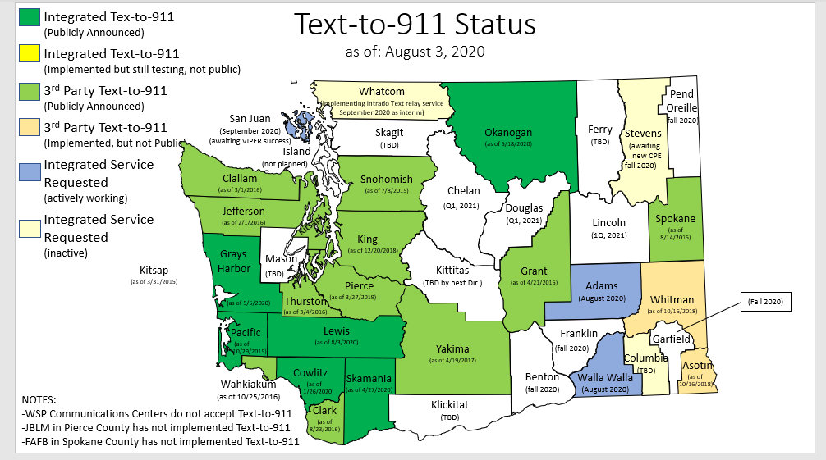

Text –to- 911
Current Status
WA State
KNOW YOUR LOCATION

Slide 6
Reasons to Text 911
Deaf, hard of hearing or speech impairment
Unable to speak while a crime is in progress. Speaking may cause harm / must remain quiet to stay safe.
  Domestic violence
  Home invasion
  Kidnapping
  Human trafficking

Slide 7
Confirmation of 911 text eligibility
Let 911 know right away that you are deaf, hard of hearing or have a speech impairment. 911 will ask if you are able to speak safely. Those able to speak safely and/or are reporting a non-emergency will be directed to call 911.

Slide 8
How to text 911
Enter 911 in the “to” field
Initial text should include your location and type of emergency. If possible also notify of your deaf/hard of hearing/speech impairment status
Send message

Slide 9
Texting – What not to do
Do not use abbreviations, acronyms, slang or emojis
  Acronyms / slang / abbreviations can have different meanings depending on age, location, demographics, etc
  Emojis do not process through our texting software
Do not sent texts containing hyperlinks
  Unable to open on current system
  Will not open on future systems
    No way to know what content is
    Unable to tell what website is
    No way to know if it is a virus or not
Do not send photos or videos – we are not able to open photos or videos

Slide 10
Additional texting restrictions
Currently there is no language translation service for texts to 911
Do NOT text 911 in a group chat. It will not process correctly and will not be received by 911

Slide 11
Texting Challenges & Limitations
Not all agencies have text to 911
  Will get a “bounce back” message that texting is not available
Texting is not always instantaneous
Typing speed/accuracy not as quick as voice
Location is not as accurate
Texts may be out of order or not go through at all
Must have a data plan
  There may be charges by your carrier

Slide 12
911 will process and triage texts with the same priority as voice calls. Text messages DO take longer to process for a variety of reasons and there are some limitations for texting to 911.

Slide 13
Call/Text processing – what 911 needs to know
Location – where is the emergency/where did it happen
Nature of emergency – what happened
  Time delay – when did it happen, is it still going on? Is the suspect still in the area?
Who is involved? What does the suspect look like?
Associated vehicles
Are any weapons involved? If so who has them and where are the weapons.
Has anyone been drinking or doing any drugs? Any mental health concerns?

Slide 14
Person/suspect descriptions
Race
Sex
Age
Height / weight
Hair color / style / facial hair
Clothing descriptions
  Top to bottom
  Outside working inward
Shoes / glasses / bags / backpacks
Tattoos

Slide 15
Vehicle Descriptions
Color
Year
Make / Model
Body style
License plate
Special features
  After market additions
  Bumper stickers
  Body damage

Slide 16

It is important to stay calm and be as detailed as possible.
Try and answer all questions asked – IT WILL NOT DELAY RESPONSE.
Know your location!

Slide 17
Questions?

Slide 18
Speaker information:
Michelle Thomas – 911 Public Education Coordinator, Master Dispatcher, Tactical Dispatcher
mthomas@cob.org
360-676-6911

